Slide 1


Analysis on texture synthesis
Jason Plawinski, Matsushita Lab.
Suita, Osaka
November 2017

Slide 2

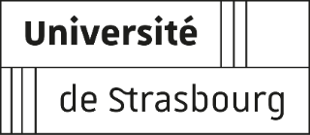
Outline
Presentation Outline
Non Parametric Sampling
Pyramid based synthesis
Image Quilting
Random Phase Noise
Result comparaison
Performance

Slide 3
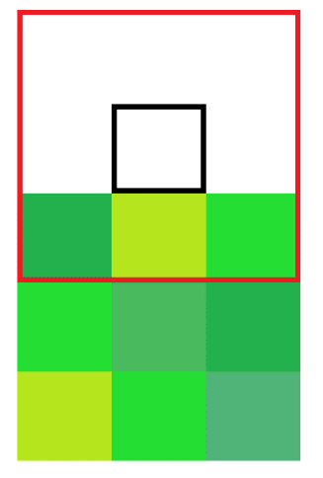
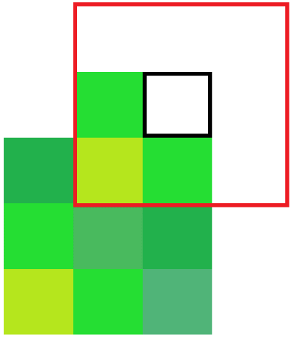
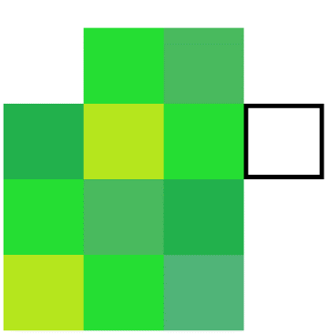

Non-Parametric
Non Parametric Sampling (1999):
Start with a 3x3 seed
Look for the pixels with the neighbors
Compute the squared error between the patch and every patch in the training image
Select the pixel with the lowest error
Example of the generation of an image with a 3x3 window

Slide 4
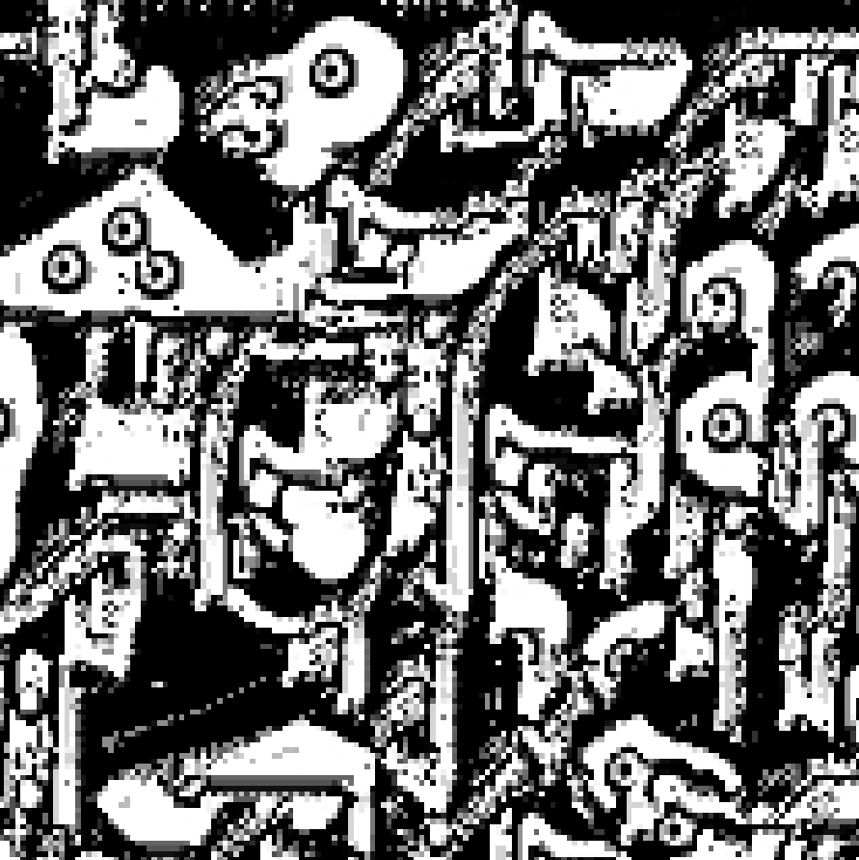
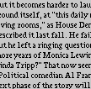
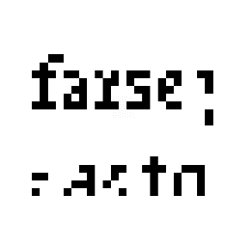
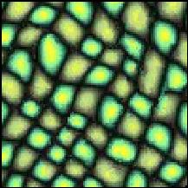
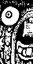
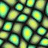
Non-Parametric
Non Parametric Sampling (1999):
Advantages | Drawbacks
Visually good results | Really slow
Intuitive implementation | Edges are not well utilized
Natively works with colors | No proof of convergence (can get stuck)
Low number of hyperparameters | Important hyperparmater

Slide 5
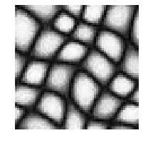
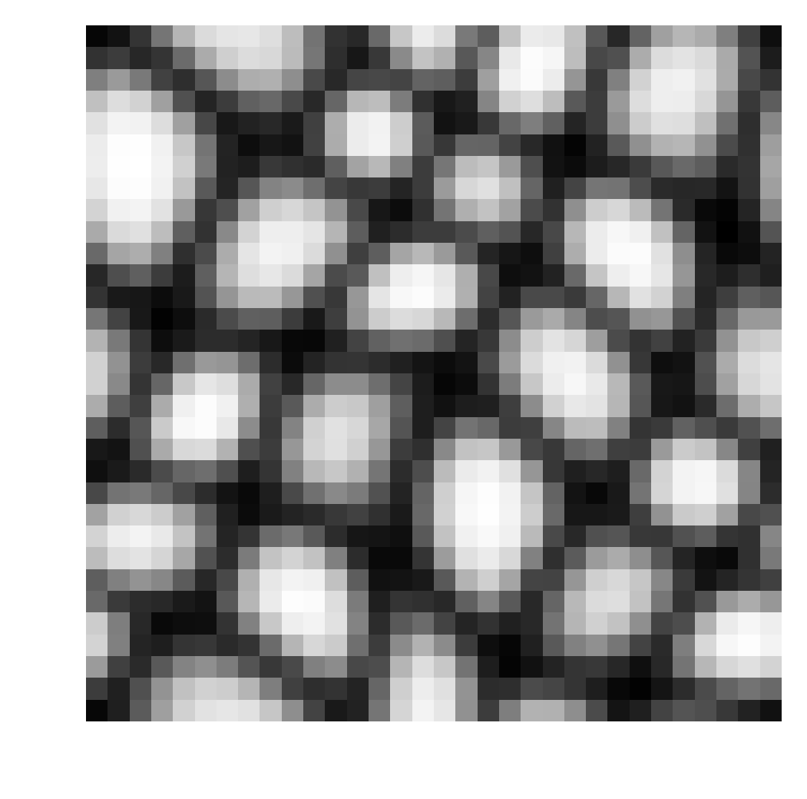
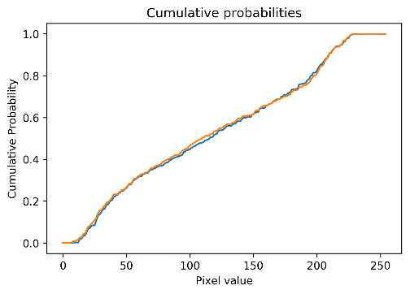
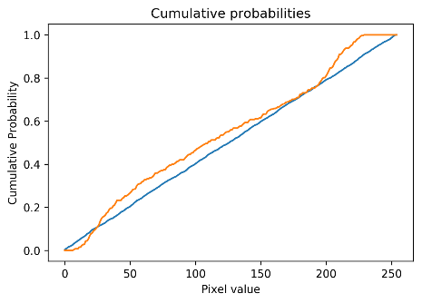

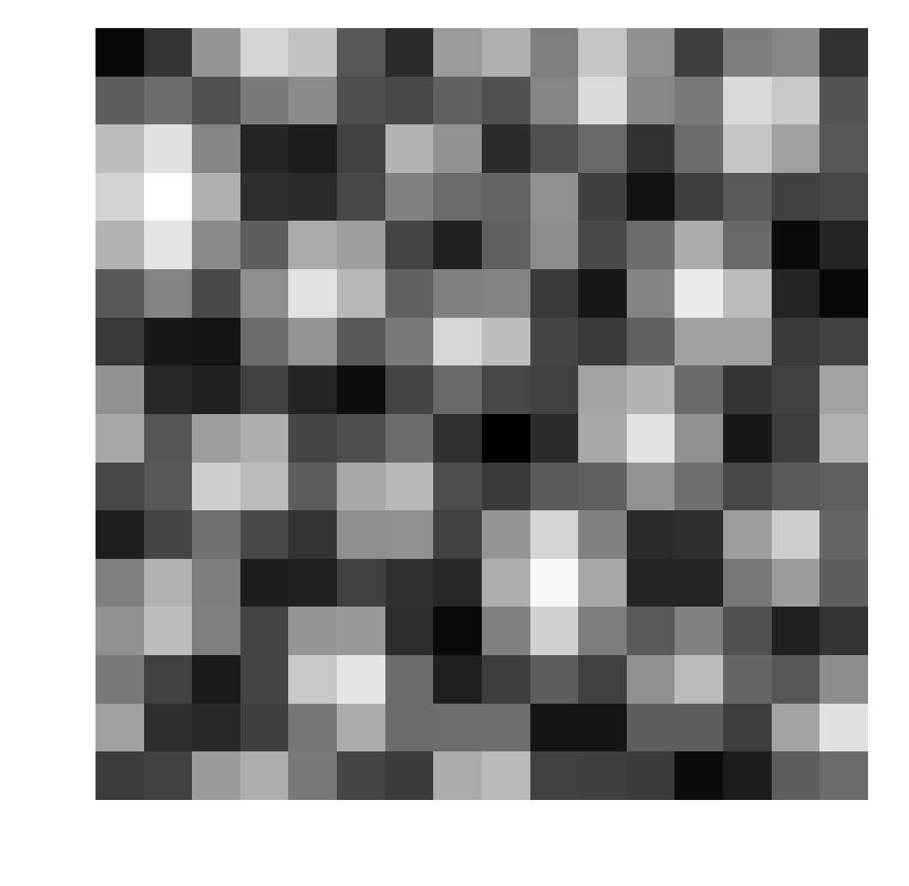
Pyramid-based
Pyramid-Based Synthesis (1995):
Start with uniform noise
Filter and down sample the training and the noise image to create a 2 pyramids of low-pass and band-pass images
Equalize the probability distribution of the noise filtered image and the training filtered images
Recontruct the final image by collapsing the noise pyramid the other way

Slide 6
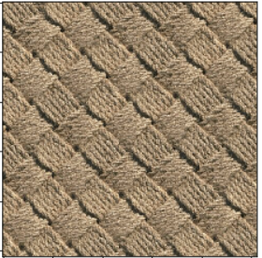
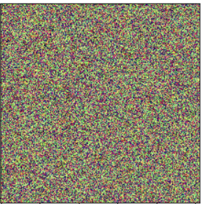
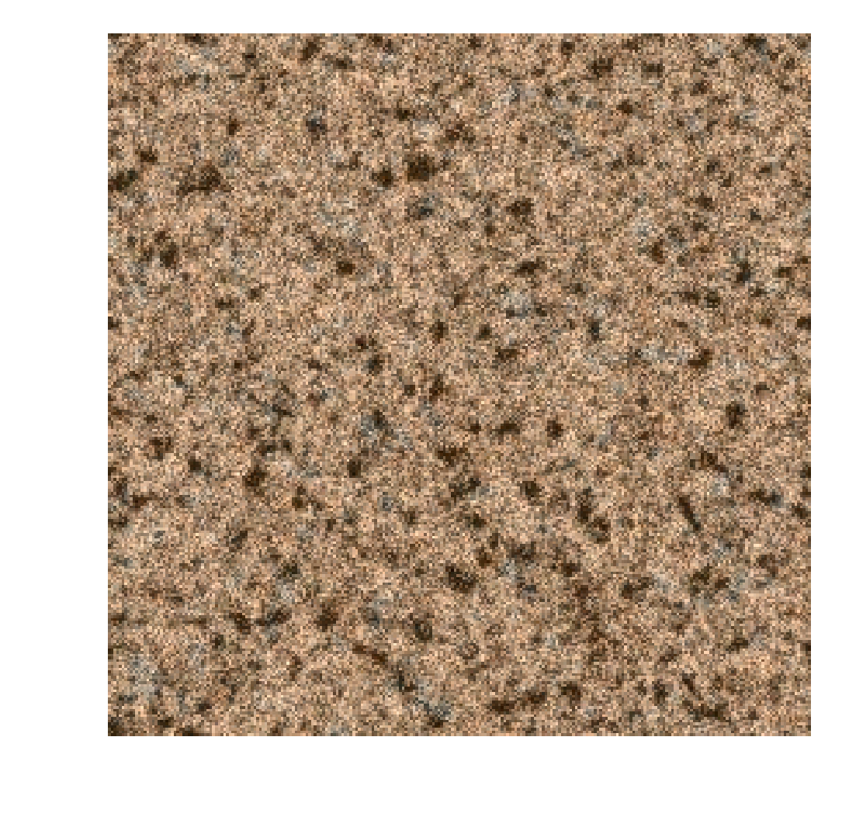
Pyramid-based
Pyramid-Based Synthesis (1995):
Implementing color :
The color synthesis is done by applying 3 separate synthesis in an alternative space where components are independent.
The synthesis space is obtained via PCA after centering the data around 0.
Correlated color channel
Decorrelated color channel

Slide 7
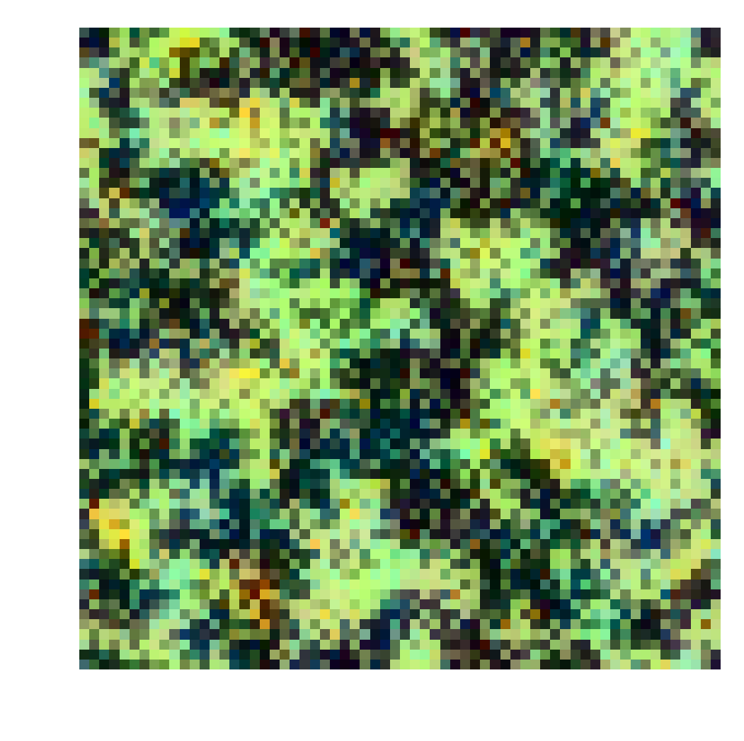
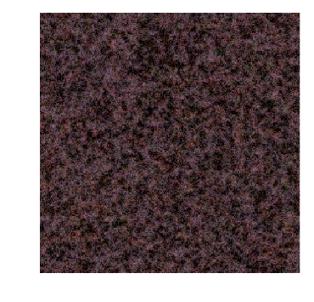
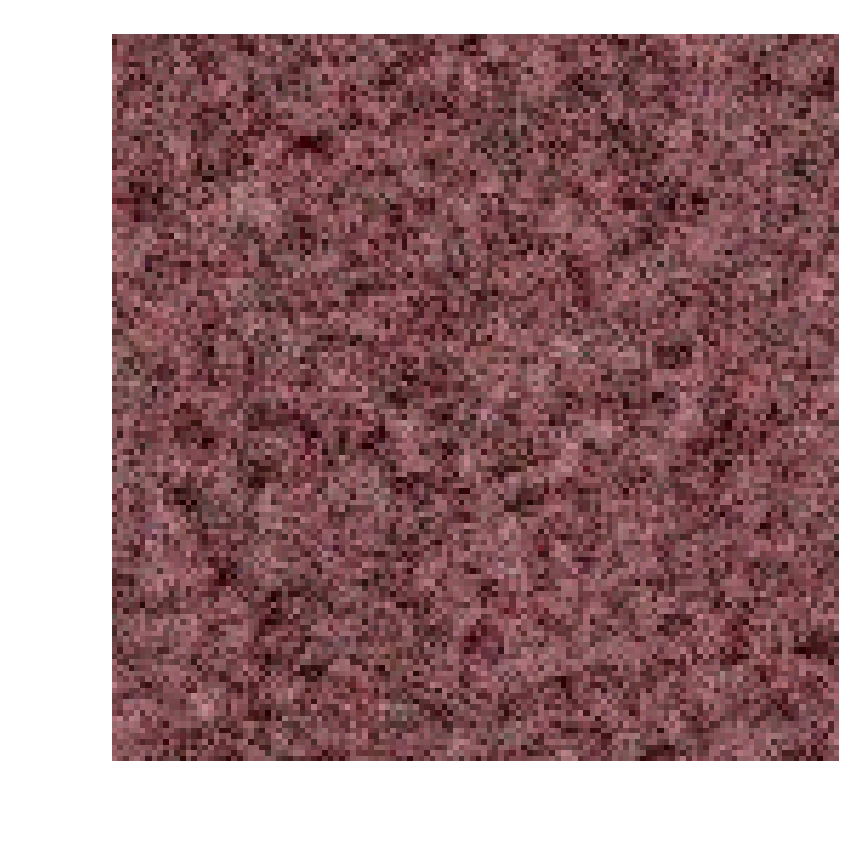
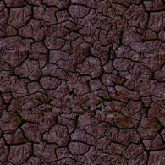
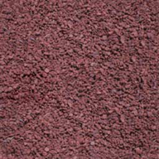
Pyramid-based
Pyramid-Based Synthesis (1995):
Advantages | Drawbacks
Really fast | Bad results
Basically no hyperparmater | Non adaptable filters
 | Almost no spatial contributions
 | Stochastic textures are rare

Slide 8
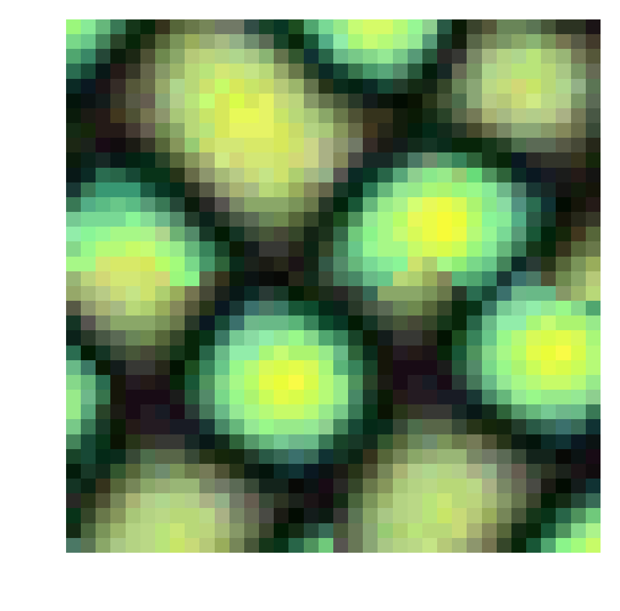
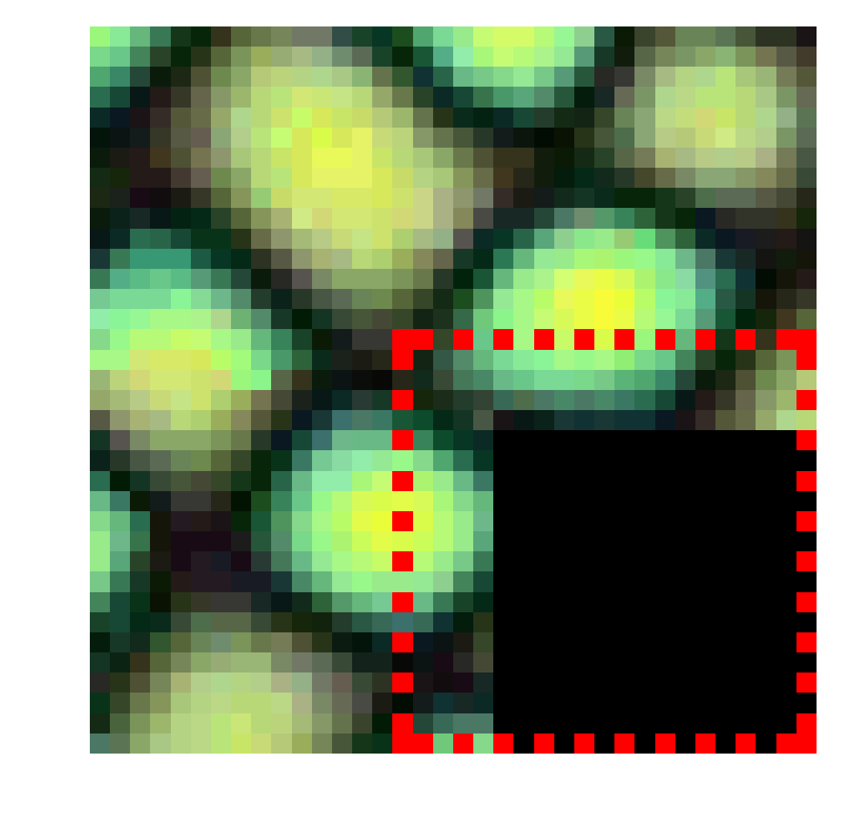
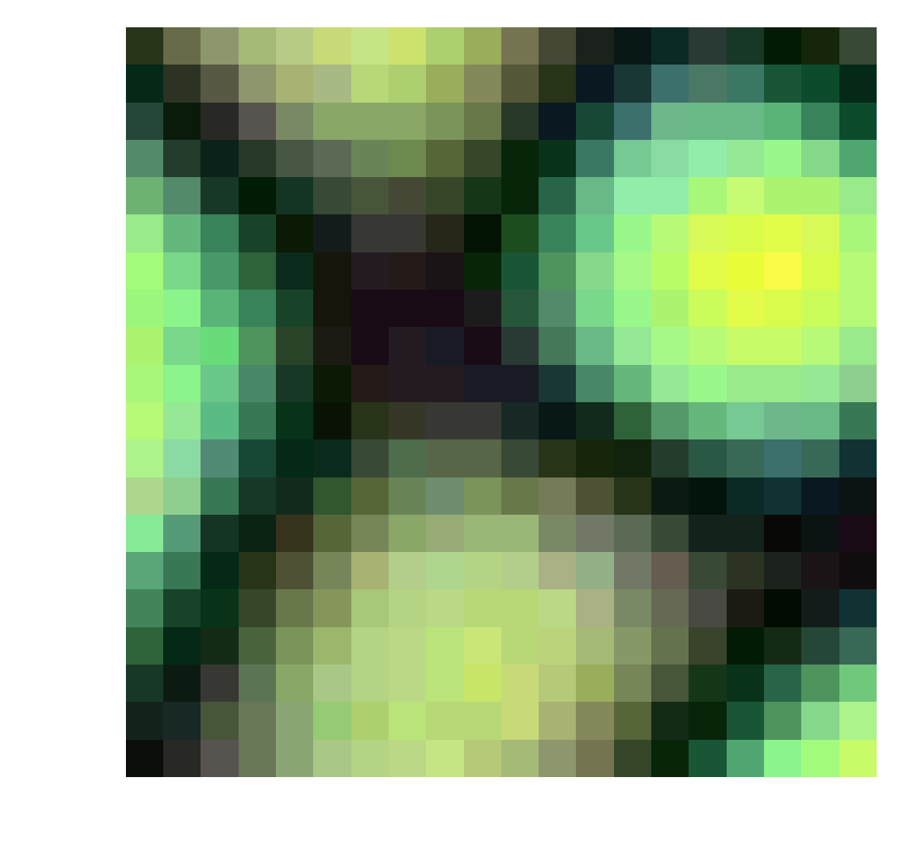
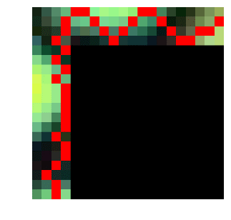
Image Quilting
Image quiting (2001):
Patch based method: quite similar to the non parametric approach but copies entire patches instead of pixel by pixel
In this implementation, patches are allowed to overlap and on the overlaping area, the algorithm computes the cut that minimizes an error function
Selecting the next patch with overlap
Selecting a patch with a low error
Computing the optimal boundary
Quilting the new path in the output texture

Slide 9
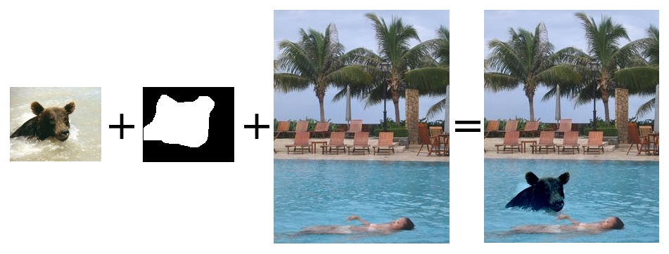
Image Quilting
Poisson blending(2003):
Poisson Blending: Applying a poisson blending can improve of image quilting.
Poisson blending are used to superimpose 2 images seamlessly and is computed as a guided interpolation.
Poisson blending: http://cs.brown.edu/courses/csci1290/2011/asgn/proj2/

Slide 10
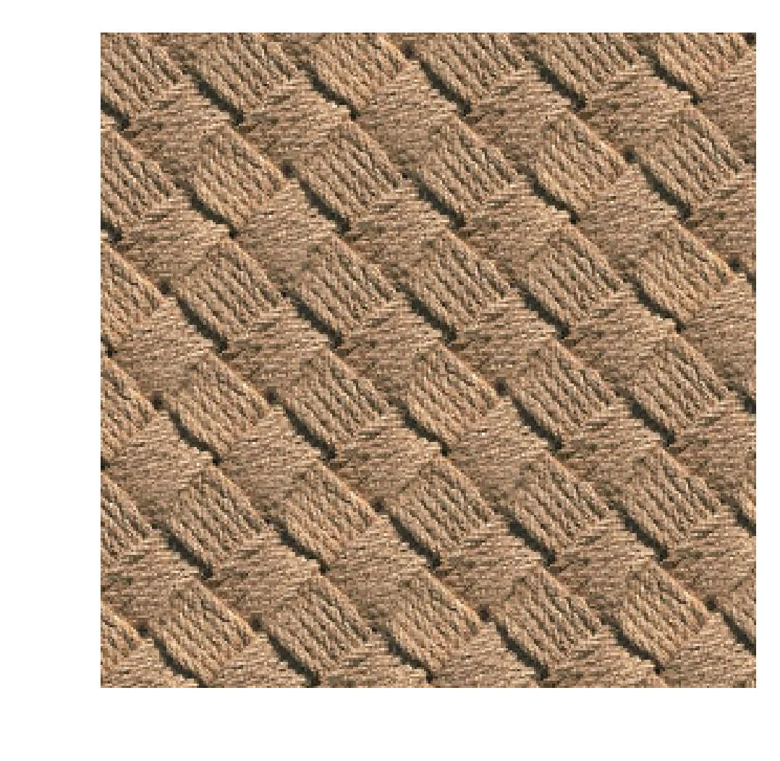
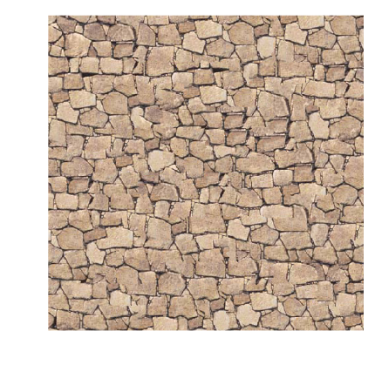
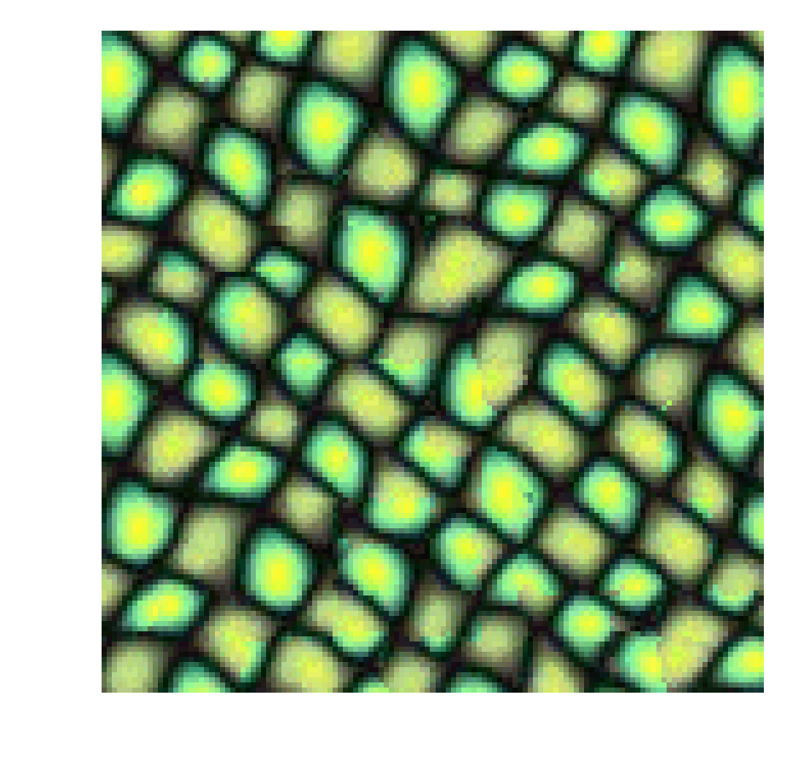
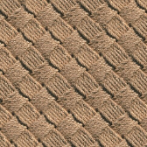
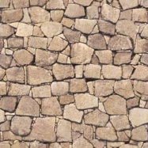
Image Quilting
Image Quilting (2001):
Advantages | Drawbacks
Visually good results | No proof of convergence (can get stuck)
Decently fast | Patch artefacts
Natively works with colors
Low number of hyperparameters

Slide 11
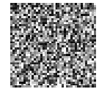
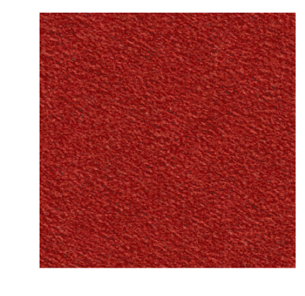
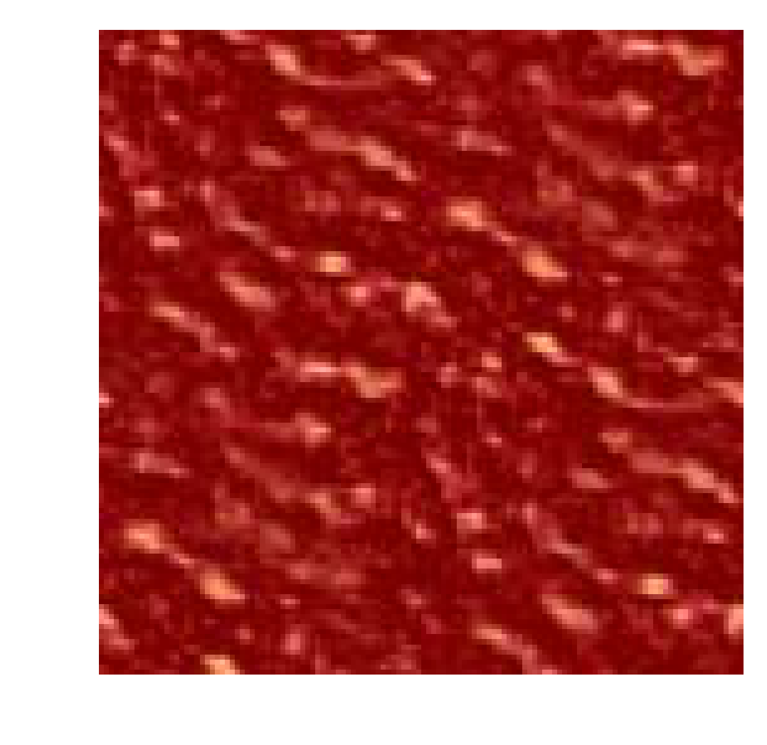
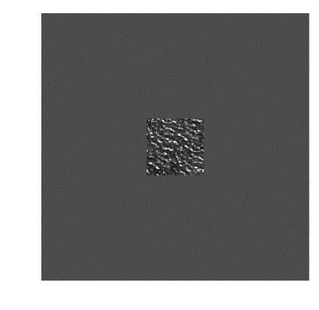
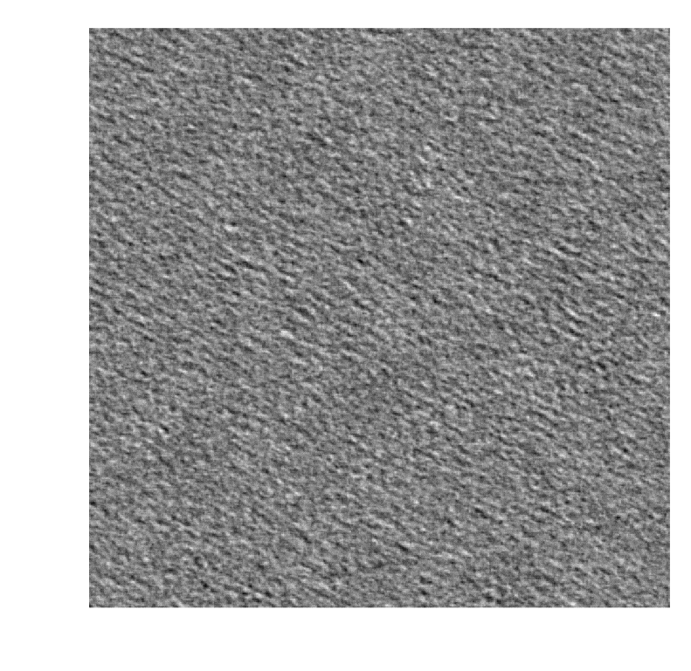
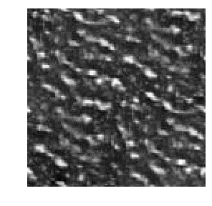
RPN
Random Phase Noise (2011):
Parametric synthesis: In this algorithm, the image is divided into a periodic component and an edge component. The synthesis is done by expanding the periodic and then adding uniform noise to the phase of Fourrier’s transform.
The periodic component decomposition is detailed in this paper.
Input Image
Output texture
Periodic component
of 1 channel
Expansion of the periodic component
Single channel Texture

Slide 12
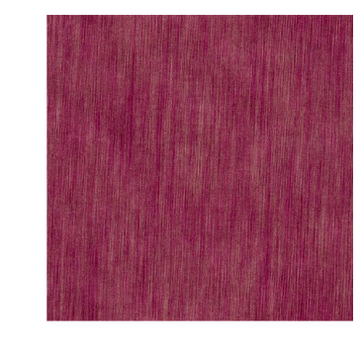
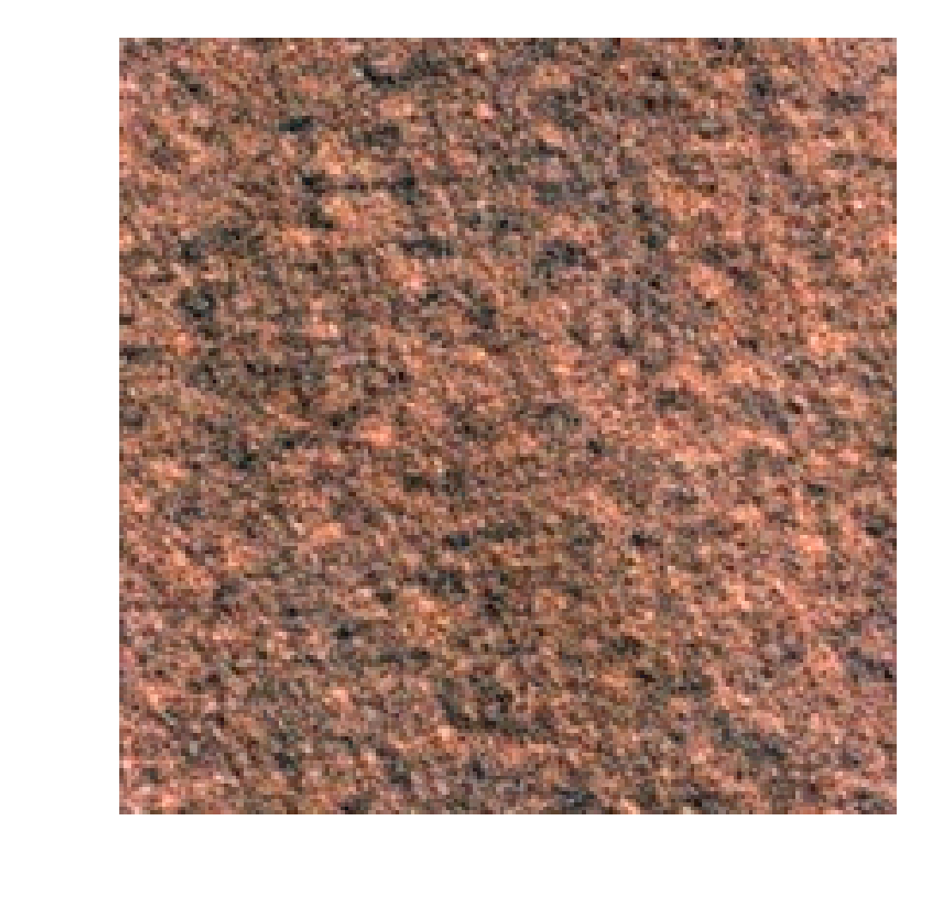
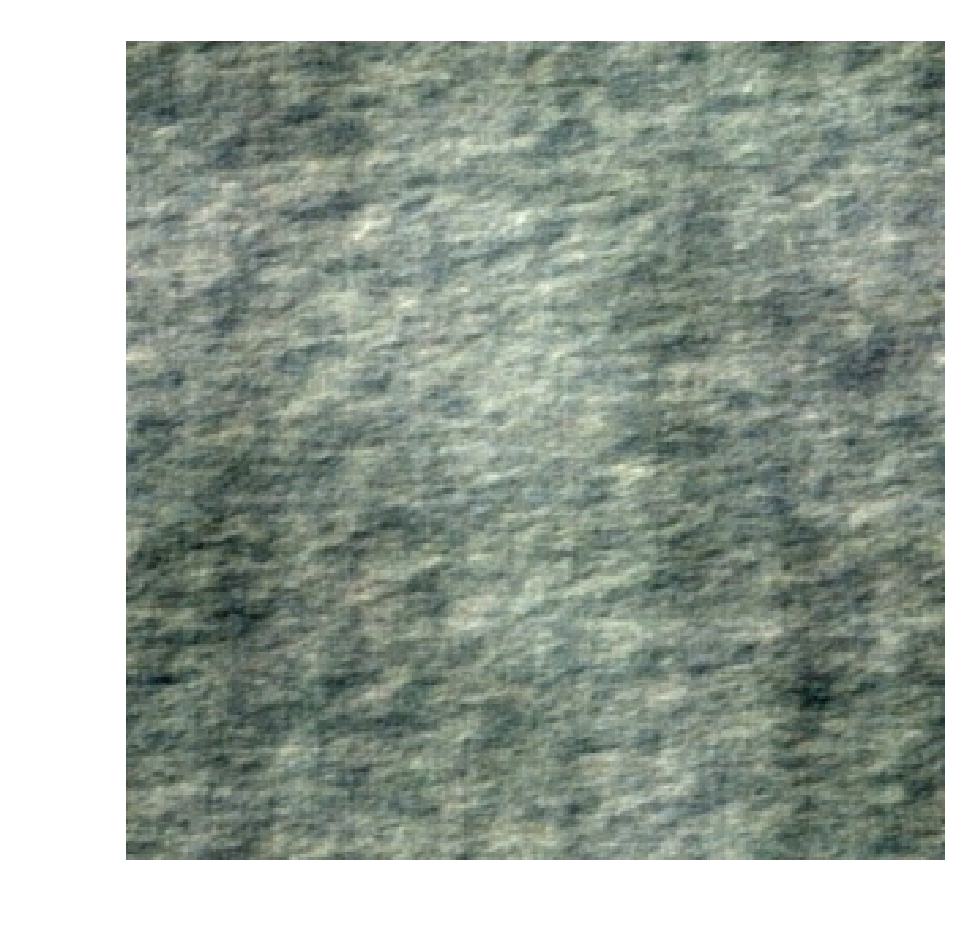
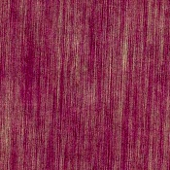
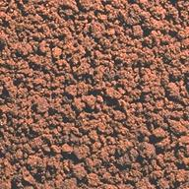
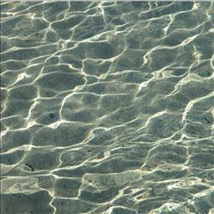
RPN
Random Phase Noise (2011):
Advantages | Drawbacks
Really fast | Bad results on non stochastic textures
Good results on stochastic textures | Needs larger size input image
Homogenous texture
No hyperparameters

Slide 13
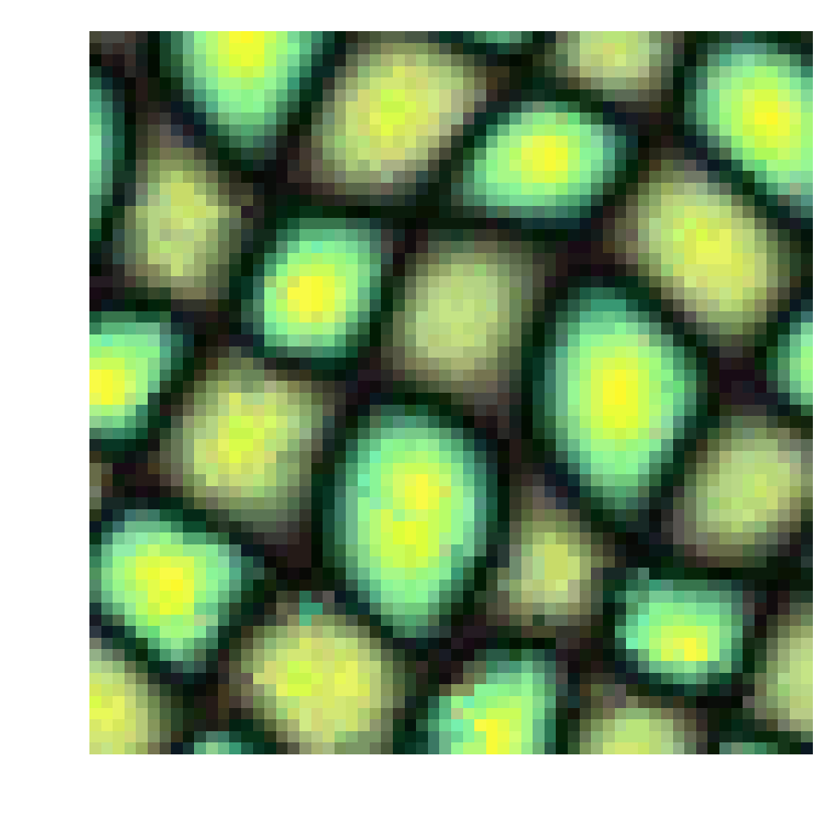
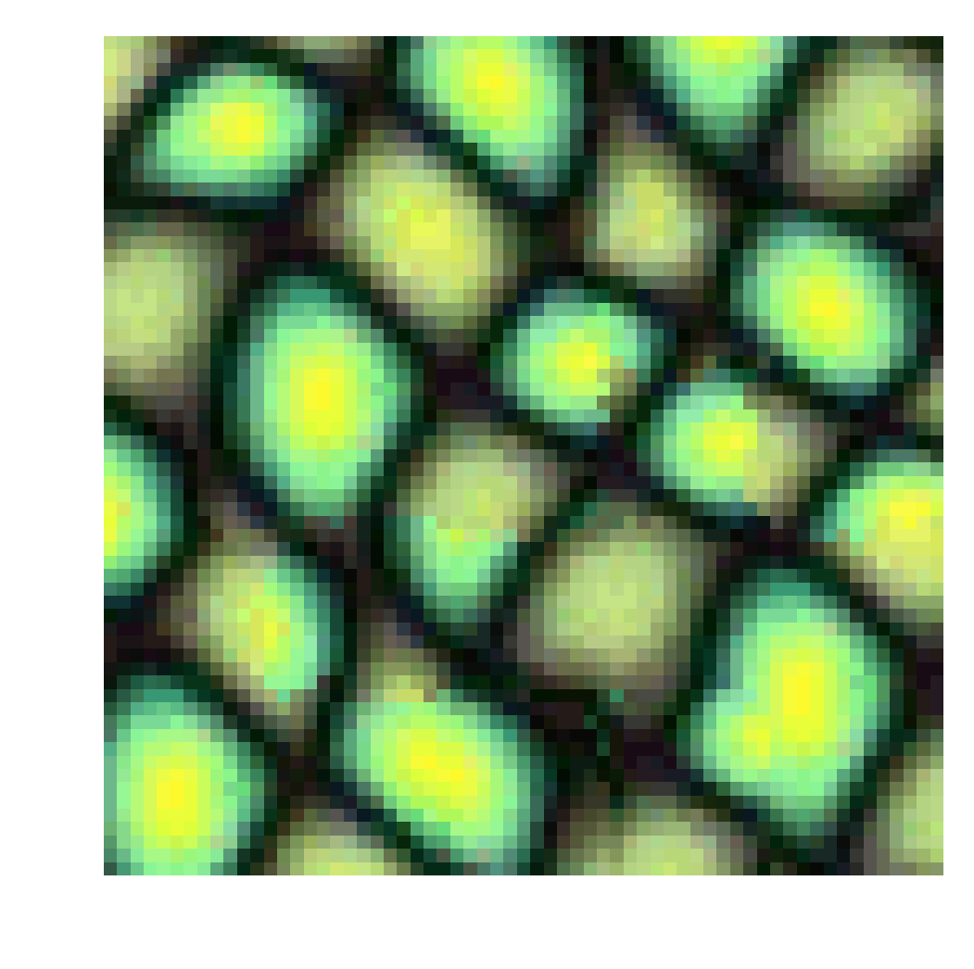
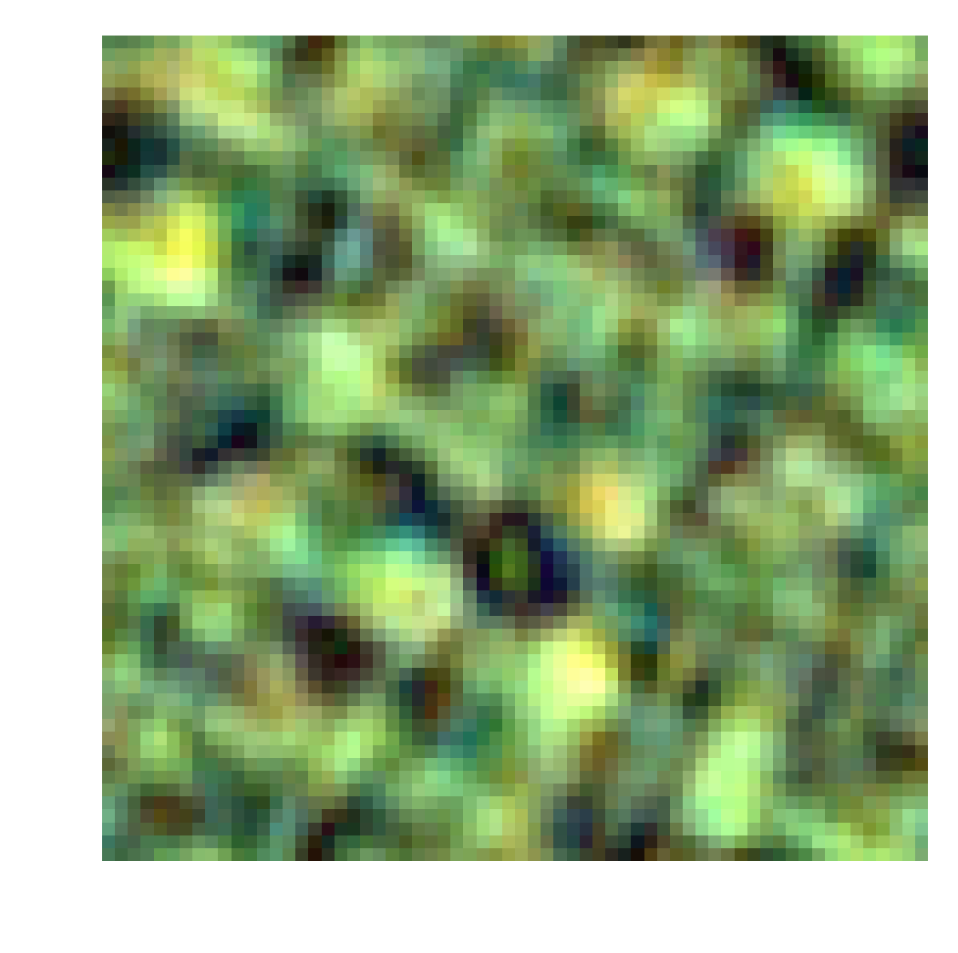
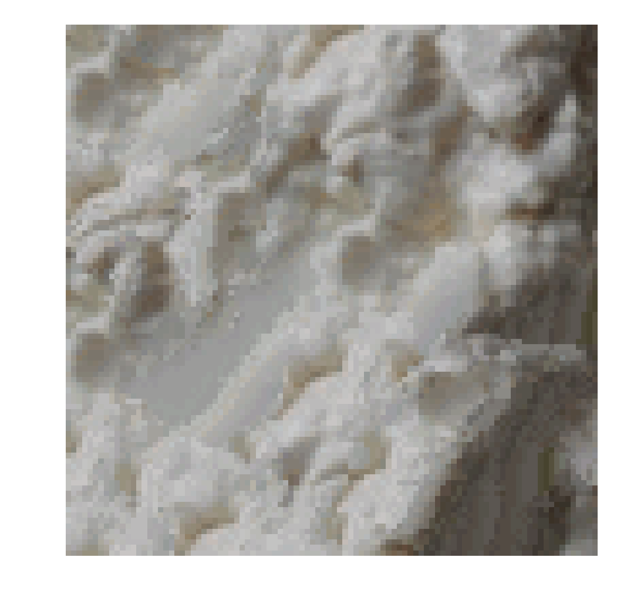
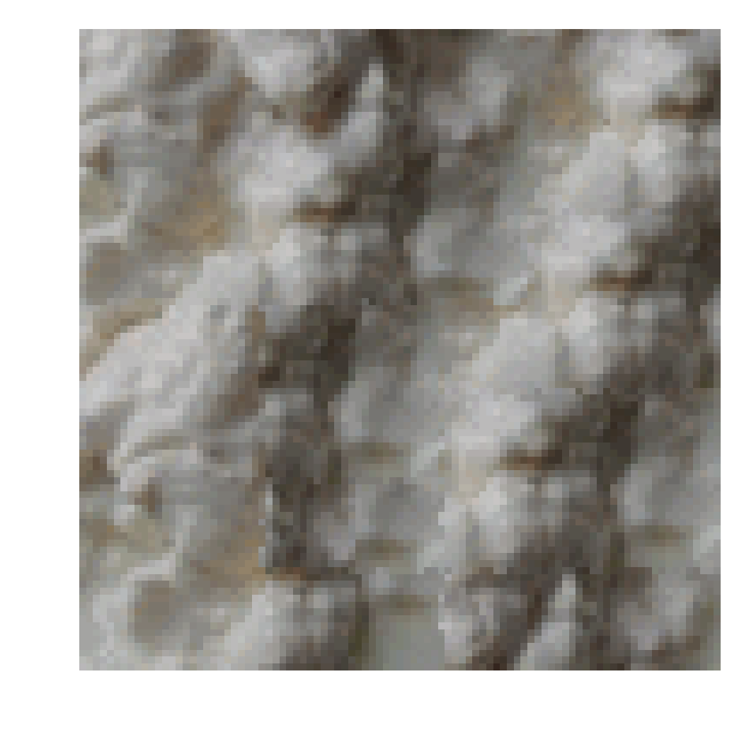








Results
Algorithm comparaison
Input Image
Non Param
Quilting
RPN
Pyramid

Slide 14












Results
Algorithm comparaison
Input Image
Quilting
RPN
Pyramid

Slide 15



Results
Conclusion on results:
Non-parametric textures: They are powerful tools for a lot of texture and perform well in both regular (and near regular) and stochastic situation.
The quality of textures deteriorates the further from the source/seed it is generated and can get stuck (tendency to ‘grow garbage’)
Parametric textures: Only work well on stochastic textures which are not that common in real world examples.
The quality is similar everywhere in the picture
Input image
Gets stuck
Not a stochastic texture

Slide 16
Performance
Performance of the algorithm:
Performance: The performance of the algorithm depends of both the input size and the output size.
In most cases, non parametric algorithm are much slower than the parametric ones but quilting does provided a valuable speed up.

Slide 17


Performance
Performance of the algorithm:
Asymptotic complexity: Non correlated input and output. All complexities are normalized and only their curvature matter, the more convex the slower the algorithm

Slide 18

Performance
Performance of the algorithm:
Asymptotic complexity: Linearly correlated input and output size. Only the non parametric algorithm have multiplicative relations

Slide 19
Performance
Conclusion on performance:
Non Parametric: This algorithm is much slower than all the other. The quilting algorithm is a good speed up and both implementation could be parallelized
Parametric algorithm: The parametric algorithm are conditioned by the speed of the multiple FFT used. They cannot really be parallelized and is really good for balanced input and output sized

Slide 20
Conclusion
Conclusion :
Non Parametric: This algorithm is much slower than all the other. The quilting algorithm is a good speed up and both implementation could be parallelized
Parametric algorithm: The parametric algorithm are conditioned by the speed of the multiple FFT used. They cannot really be parallelized and is really good for balanced input and output sized

Slide 21
Thank you

